Slide 1

Certification in Advanced Tech Service Engineering
Capstone Project
Case Study-2(Automation)
TSE Batch2
Team-3
11/29/2023

Slide 2
Plan
Team introduction
Case study overview
Integration with Walmart Business Process/Resource
Business Impact
Case study solution design & solution implementation
Challenges & errors encountered during solution design
Learnings & enhancements
Manager’s feedback
What extra has been implemented in the case study

Slide 3



Team introduction – Team 3
Kookutla Venkata Sai Pruthvi
Technology Services Engineer 2
Atul Pahlazani
Systems Engineer III
Ramana Vempally
Senior System Engineer

Slide 4
Agenda
Automation Overview
Understanding the case study
Case study solution design
Case study Implementation
Learnings

Slide 5
Case study overview
The retail tech support team is inundated with incidents from diverse sources, each requiring
prioritization and summarization for efficient management.
Your team’s goal is to implement automating the data consolidation process, mapping incidents to priority levels (P1 to P5) and generating five distinct files based on priority at different destinations
The team is also tasked to provide a summary for each priority queue while deleting source files and ensure error-free execution.

Slide 6
Integration with Walmart Business Process/Resources
We have integrated this with our Service Now historical data.
This allows us to have full control over the reporting system and customize reports based on needs and requirements
This Case Study made it easier to analyze the Incident data and identify the top resolvers, incidents breaching SLA, keep the management notified with the summary via automated email notifications.

Slide 7
Business Impact
This Case Study implementation will give an outline view of how many incidents are being closed on time and how many incidents have breached SLA.
This also gives an insights of where our team manual effort is put on
This also let Business knows what needs to prioritized.
This will also let us know for possibilities of finding similar pattern type of issues like issues related to module.

Slide 8
Case study solution design
Identify source paths using 'OS' module, import the csv data using 'Pandas' .
Merge source data into a single Pandas Dataframe.
Segregate the data based on priority and export into different files with encryption.
Define Priority and SLA definitions.
Iterate through each priority files and perform below tasks
Decrypt the files and read the data as Pandas DF
Filter out the data with empty/ null values
For each entry, calculate resolution time and SLA breach and add the columns to the Dataframe.
Using the columns created, calculate the top 5 resolvers and top 5 incidents exceeded SLA with Pandas inbuilt methods.
Group the data based on resolvers, Iterate through each resolver data and calculate average resolution time.
Append all the above calculations in the main summary
Prepare the summary in HTML to be sent in the Email body using 'smtplib','MIMEText', etc.
Delete the input files.

Slide 9
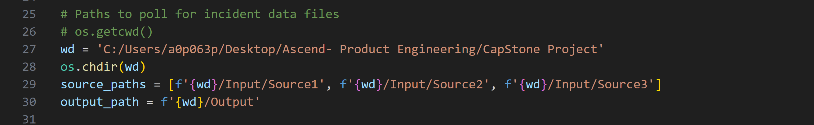
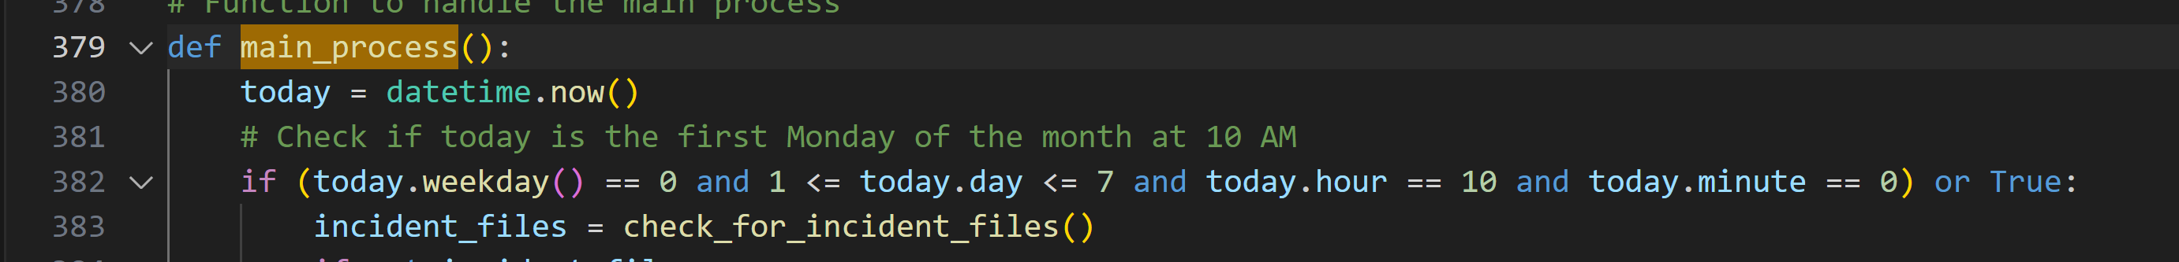
Case study solution implementation
We have pooled 3 different predefined source paths
This workflow will run on every Monday at 10 AM.

Slide 10
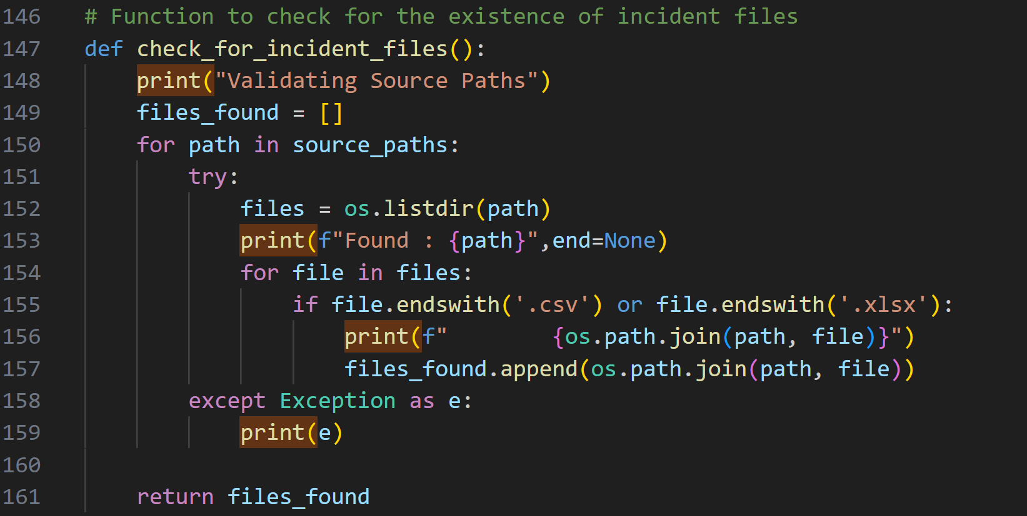
Case study solution implementation
Try to find and fetch the csv or xlsx files information from each source path.

Slide 11
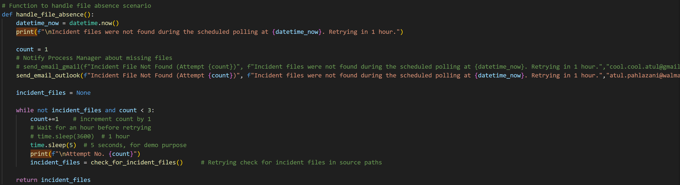
Case study solution implementation
If the files are not found. We need to repeat the process up to 3 times every 1 hour .
If we failed to gather data even after 3 attempts the main process will end.

Slide 12
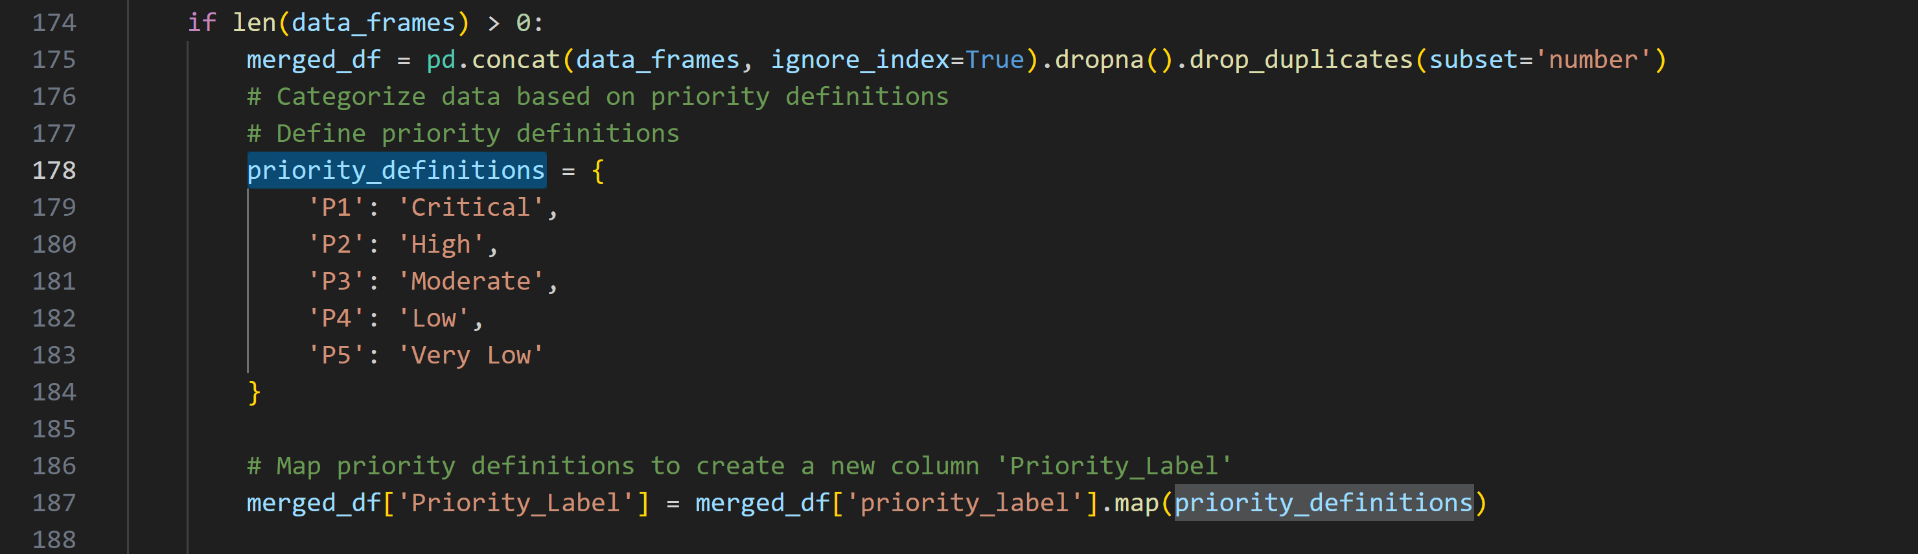
Case study solution implementation
Categorizing incident data by agreed priority definitions.

Slide 13
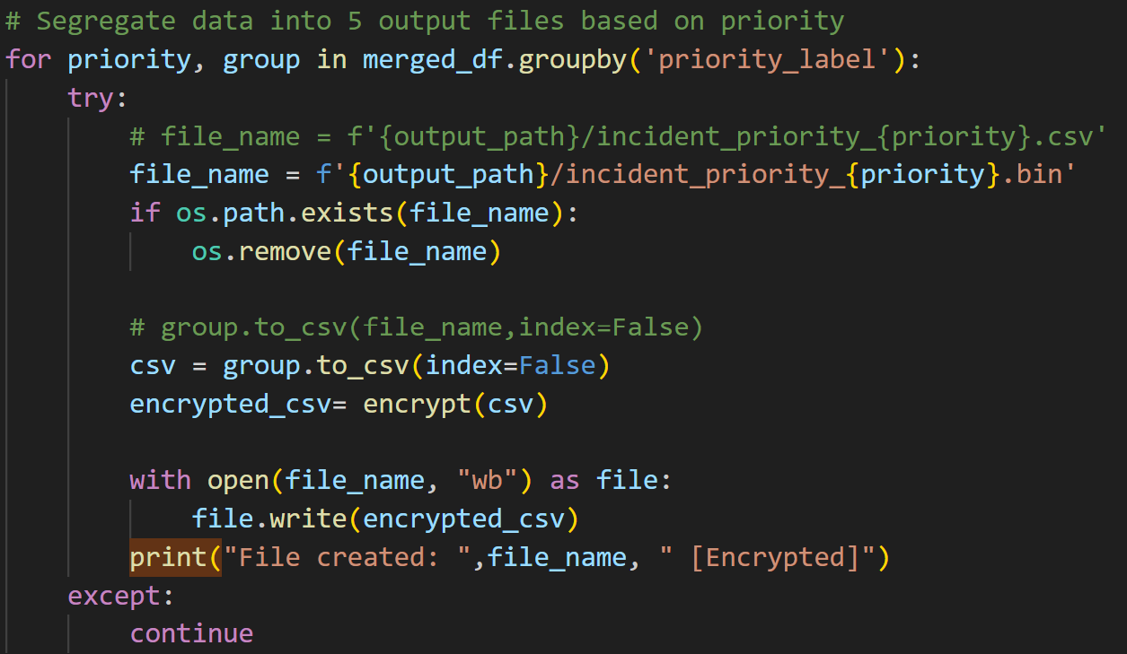
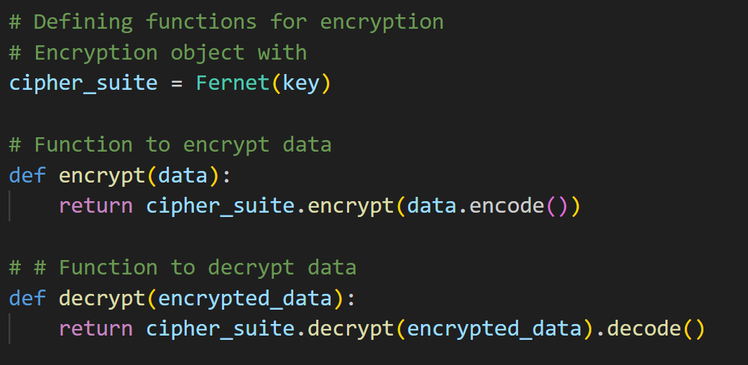
Case study solution implementation
Segregating priority wise data into 5 different Encrypted files

Slide 14
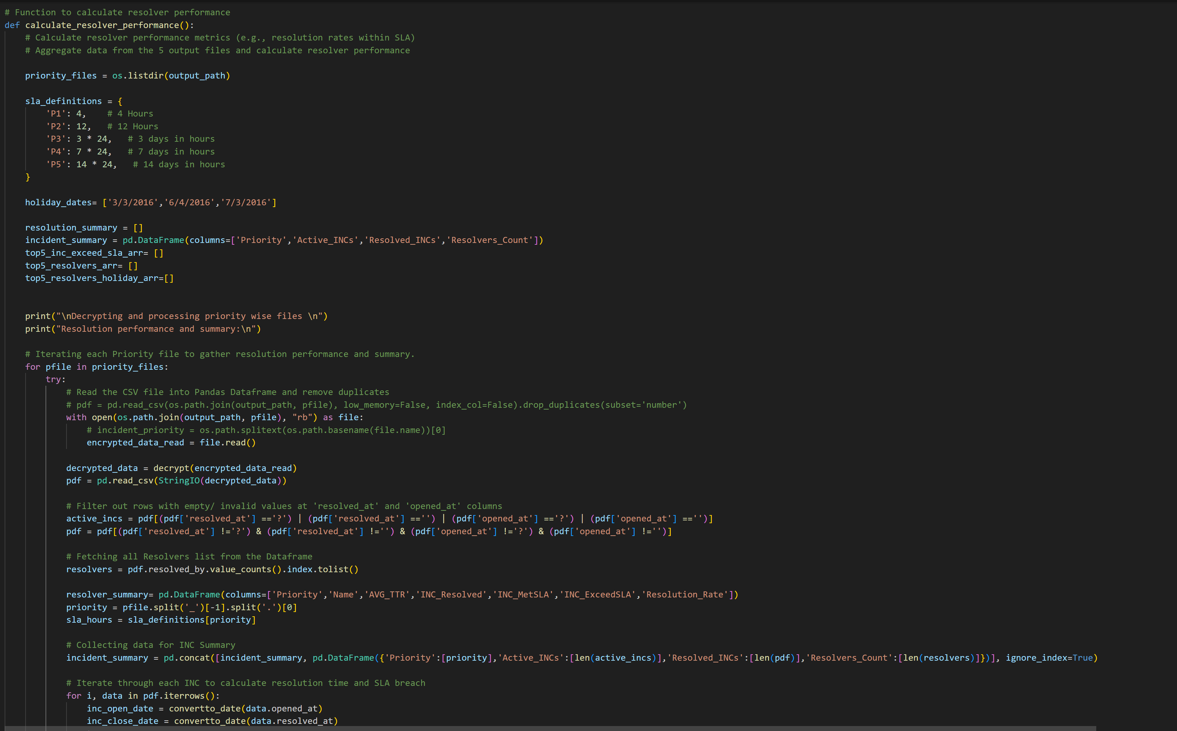
Case study solution implementation
Decrypting and processing each files and calculating the resolution time and SLA breach for ech Incident.
Which helped to identify the Top5 Resolvers,Top5 Resolvers during Holiday, Top5 INC exceed SLA and the Resolution rate for each resolver.

Slide 15
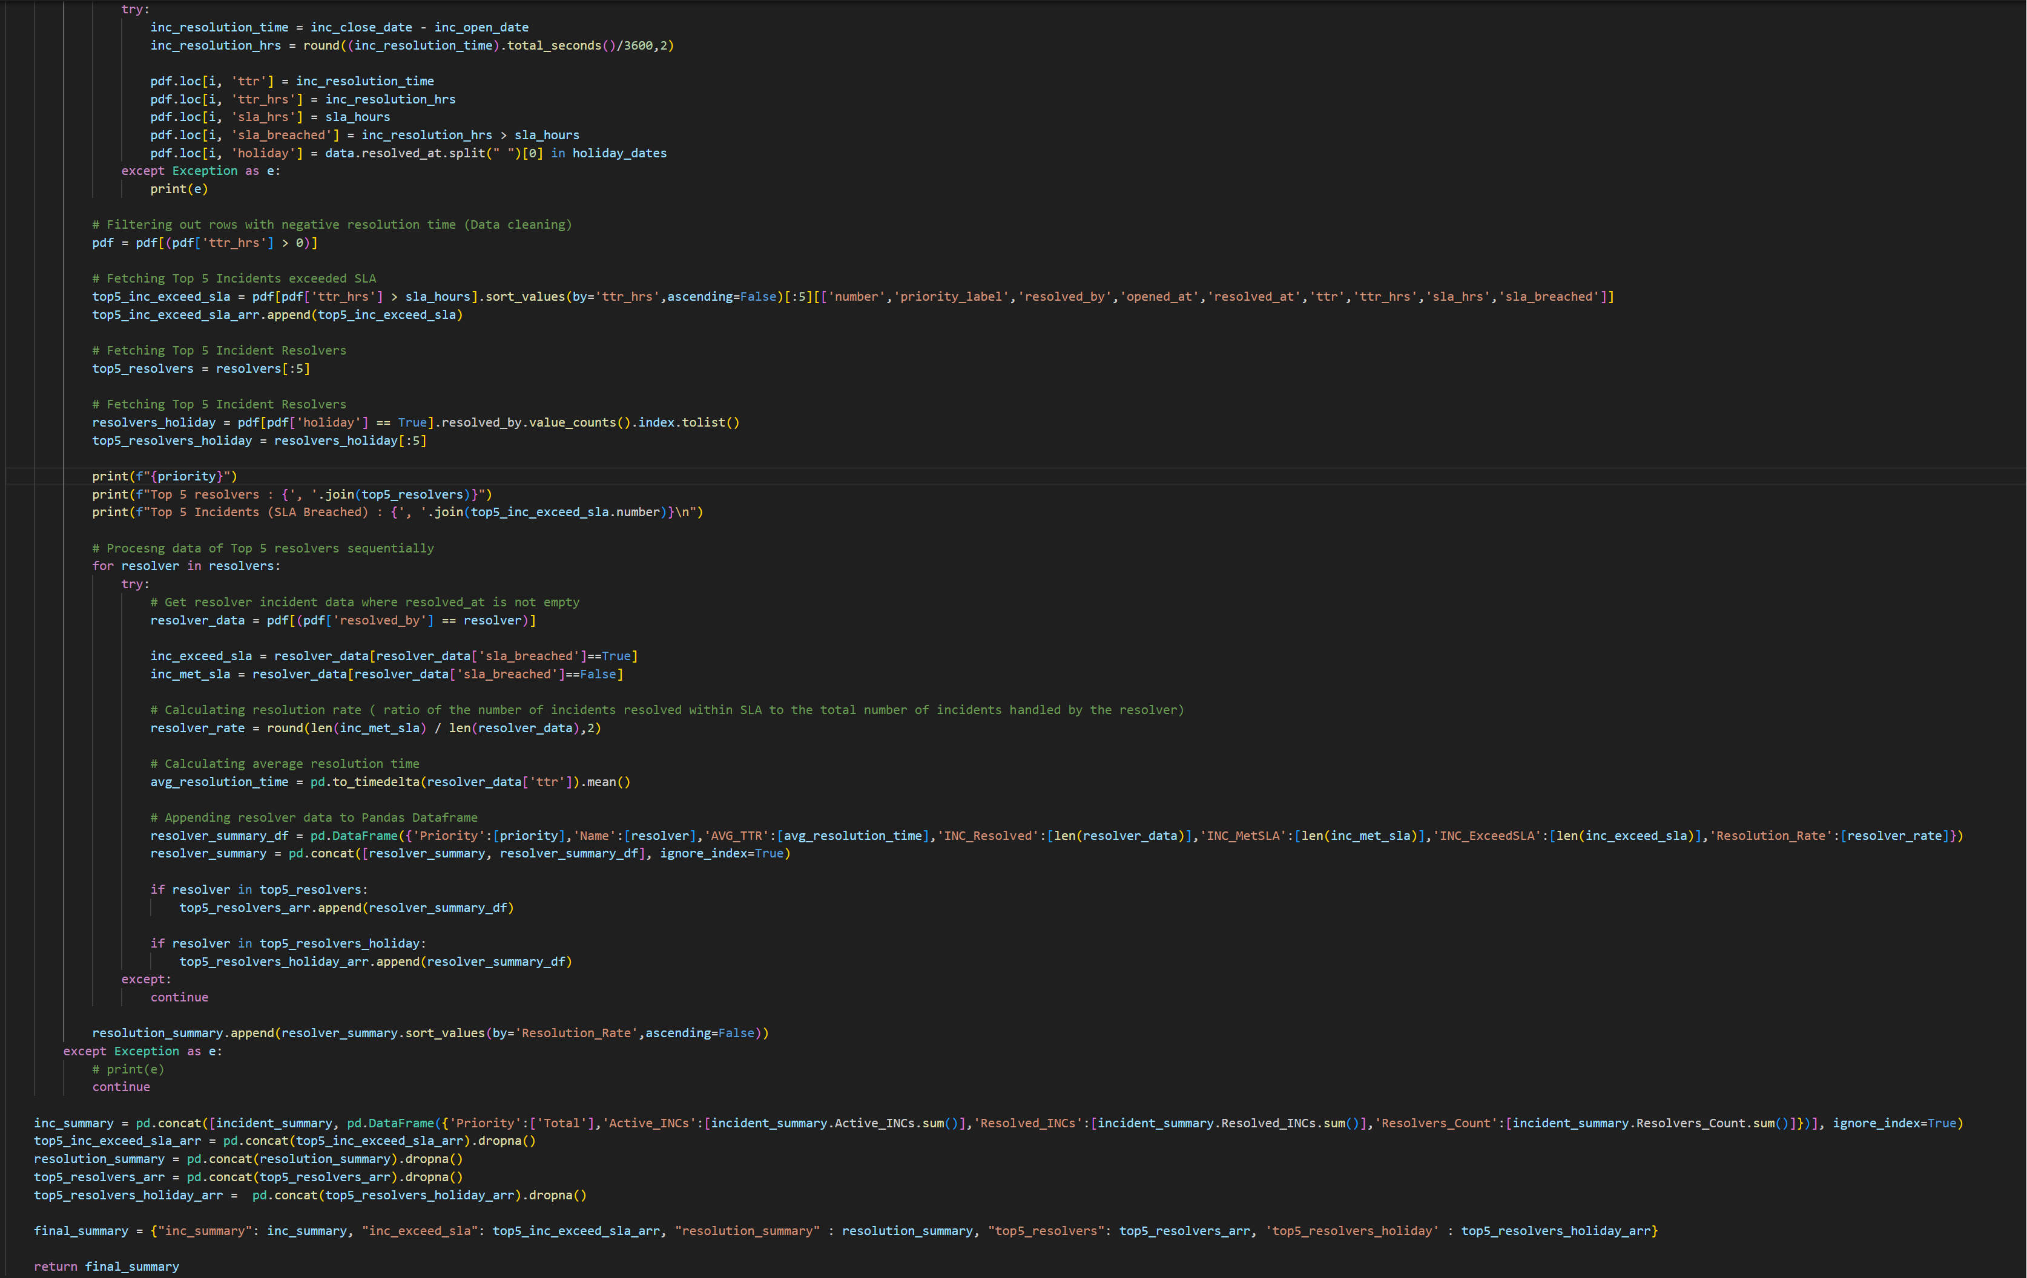
Case study solution implementation

Slide 16
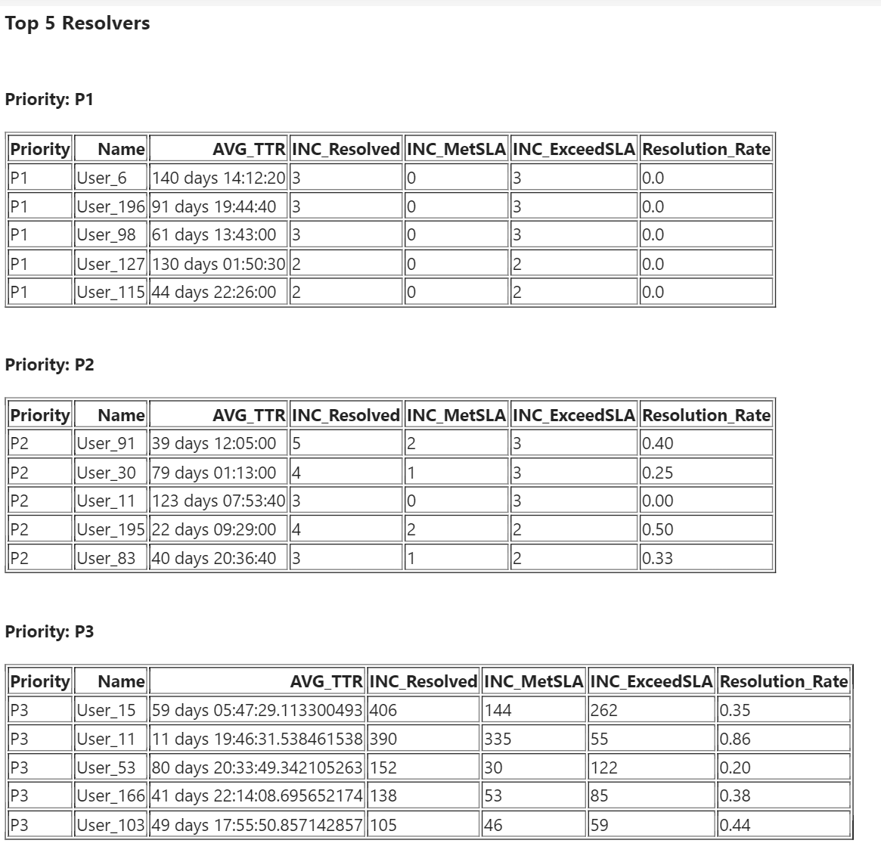
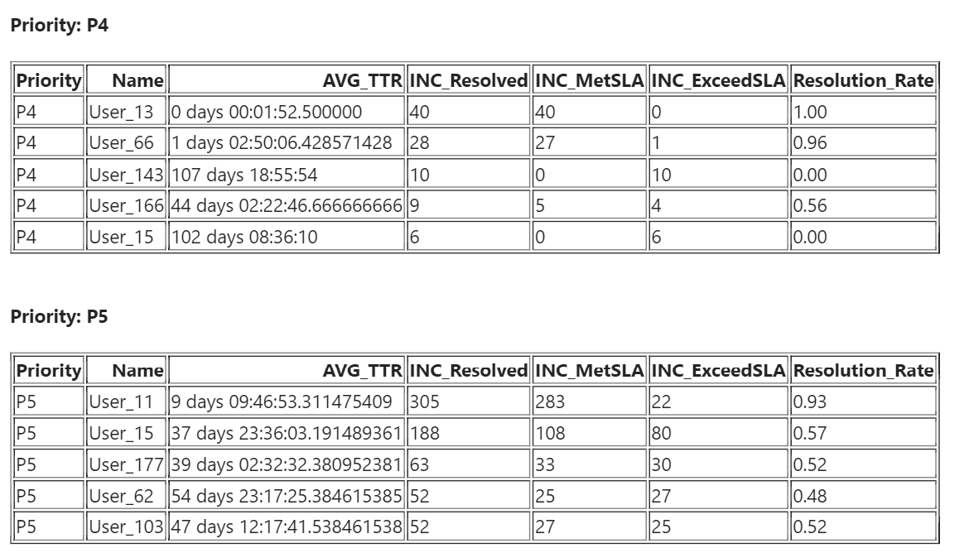
Case study solution implementation
Created summary & insights for each of the output file. Top 5 resolvers overall.

Slide 17
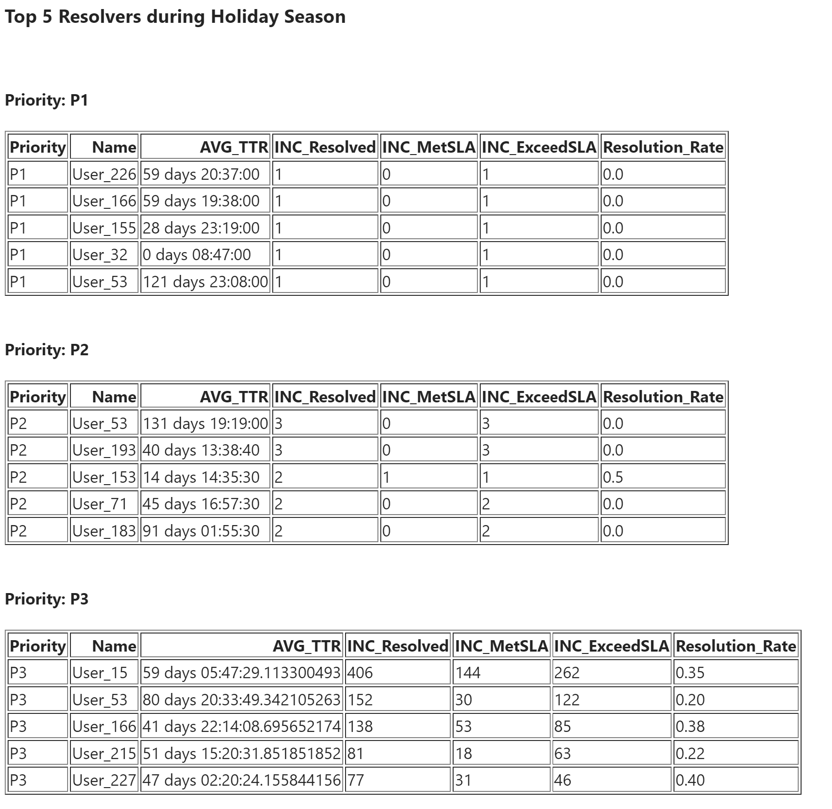
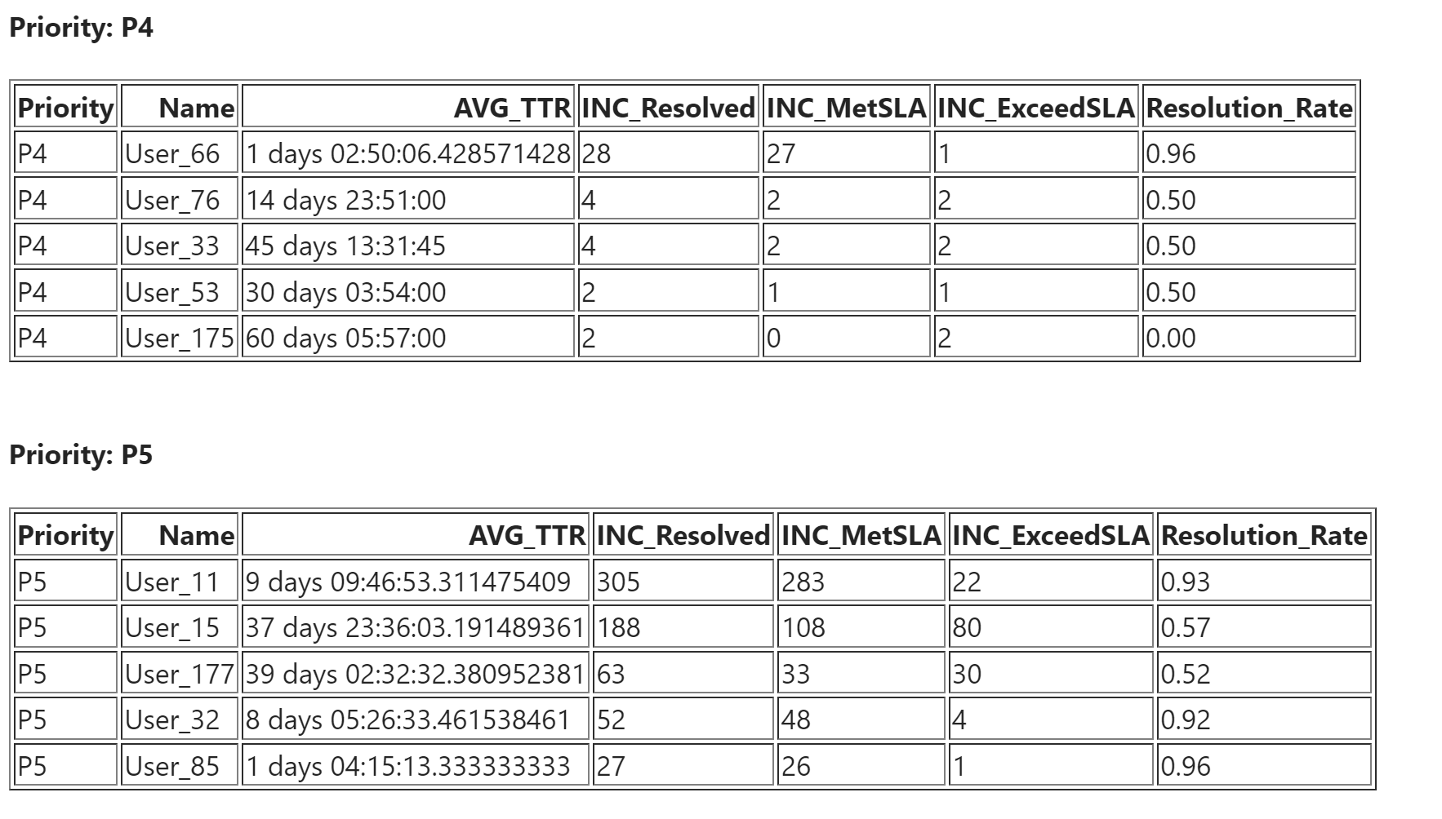
Created summary & insights for each of the output file. Top 5 resolvers during Holidays.

Slide 18
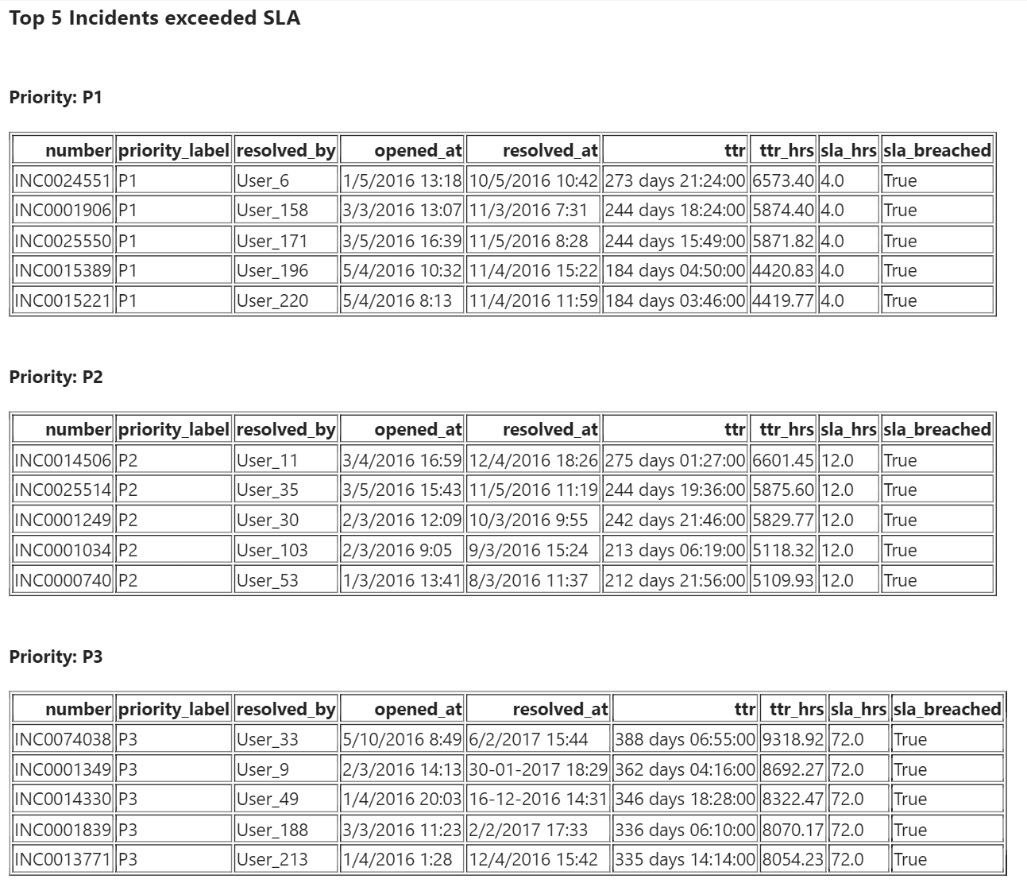
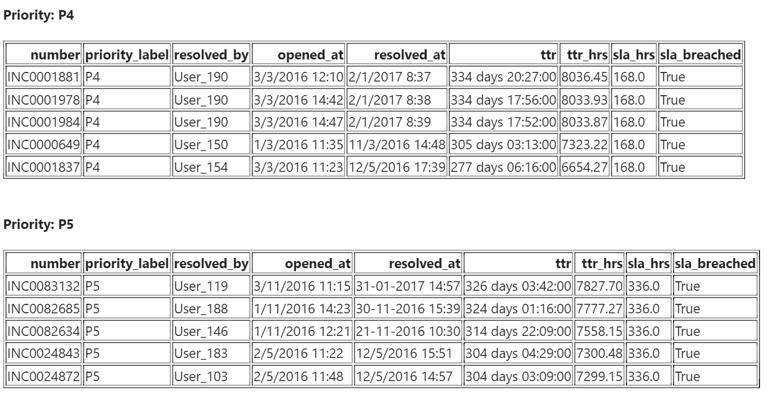
Case study solution implementation
Created summary & insights for each of the output file where top 5 incidents which exceeded the SLA

Slide 19
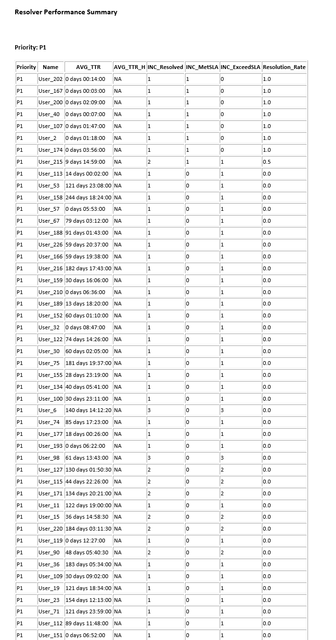
Case study solution implementation
Summary for output files which indicates the resolution rates for each resolver.

Slide 20
Case study solution implementation
These reports are Shared over email to Process Head. Those mails are attached for reference.

Slide 21
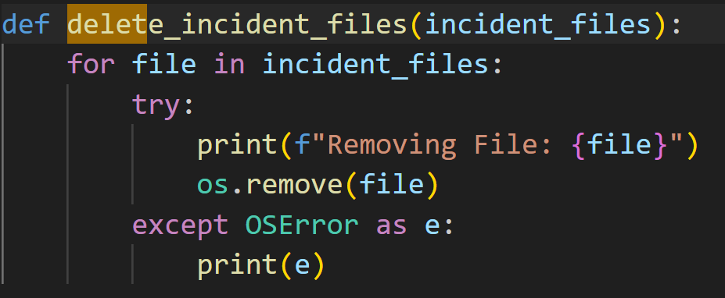
Case study solution implementation
After end of the successful processing, we are delete the incident data files at the source path.

Slide 22
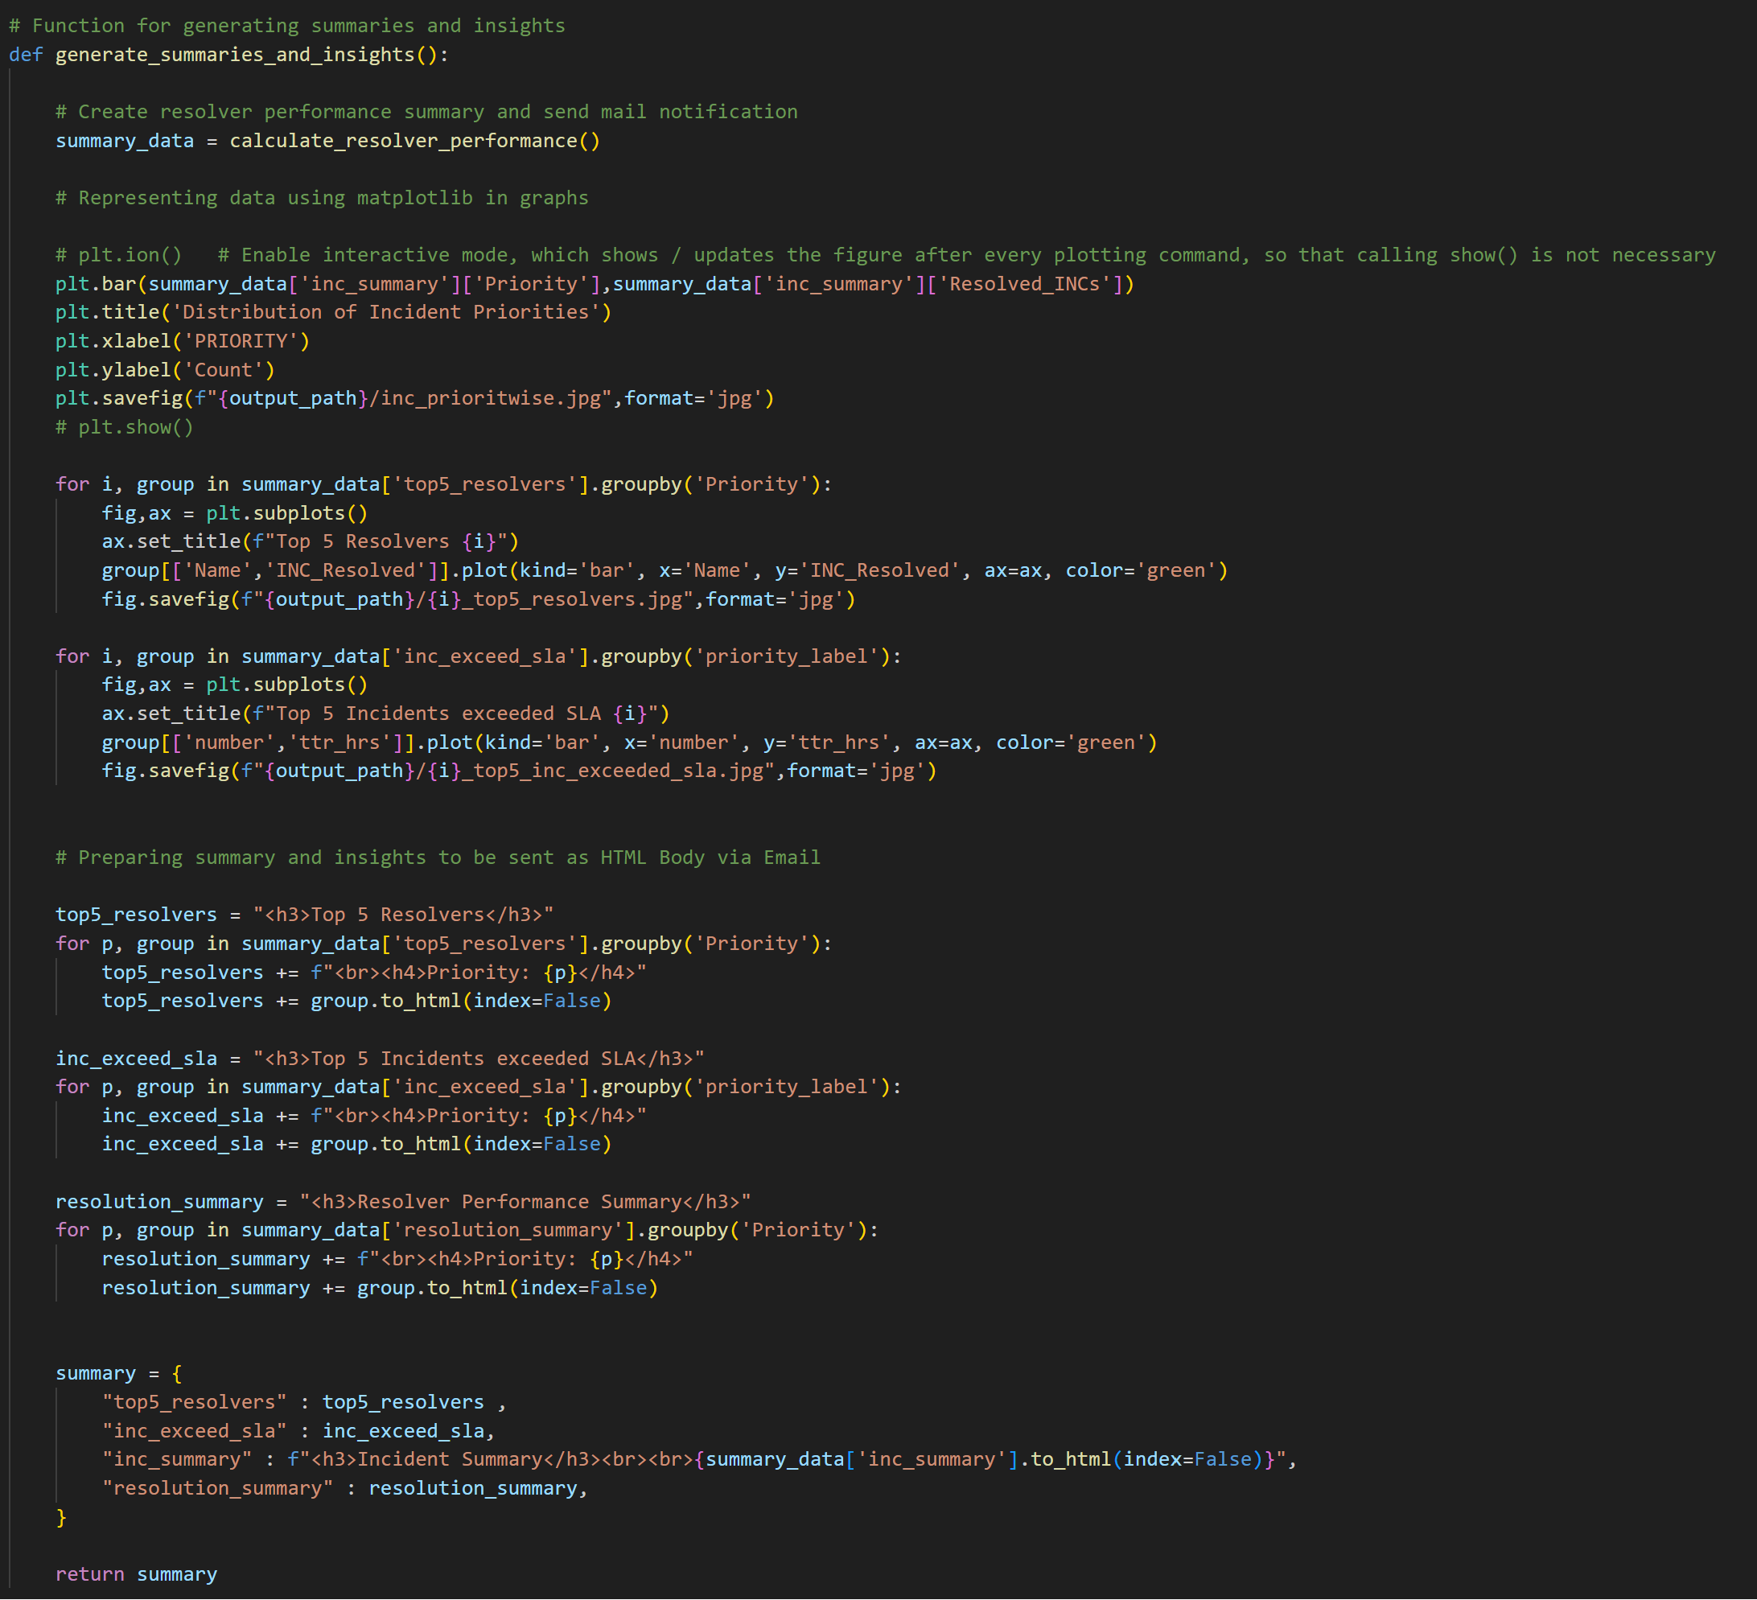
Case study solution implementation

Slide 23
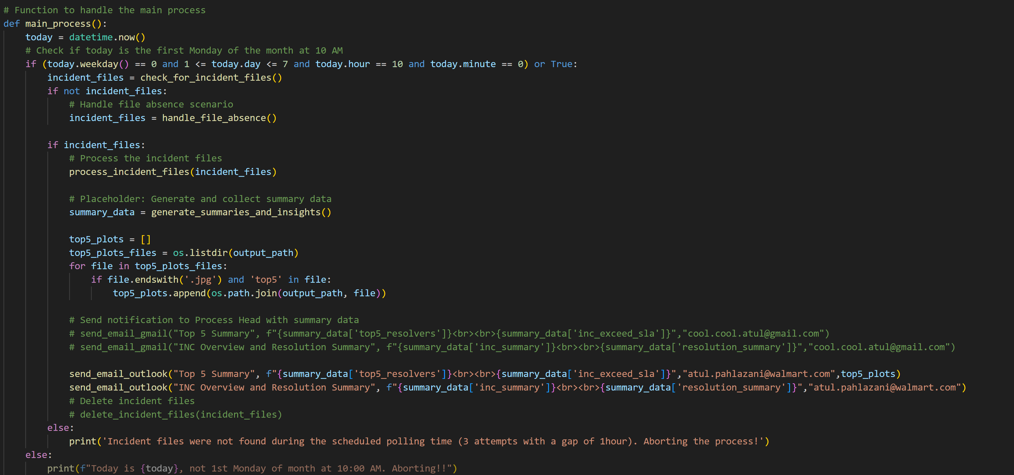
Case study solution implementation

Slide 24
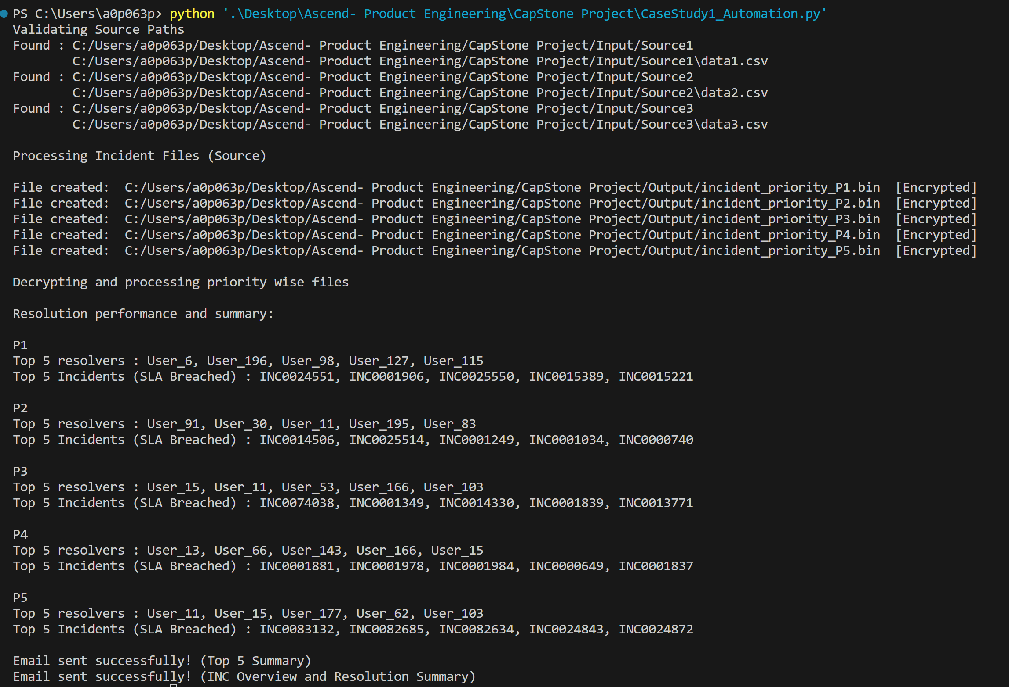
Code Execution

Slide 25
Challenges & errors encountered during solution design
The main challenge we came across is the dataset. To overcome this, we have pulled our service now Development region data for our case study
Sending mail over outlook has a challenge due to Walmart VPN/Authorization constraint . Hence, we tried to implement using Gmail and it was successful. Later we found a solution to trigger email to outlook from Python code as well (VPN network only).
Mock dataset had several issues- date format mismatch, duplicate entries, etc. Before processing for insights we identified the problematic areas and filtered the dataset to get the most curated results.
Analyzing data and gathering insights was getting repetitive and increasing the processing time. To overcome this, we iterated the data frame calculated each required value and added new columns, which made further part easier and smooth.

Slide 26
Learnings & enhancements
We learnt several integrations that can be done between various tools such as Python, libraries like Pandas, smtplib, matplotib, datetime, etc. and Excel.
Had to check the available list of activities for each tool. This exploration will help in future as well for other projects as well.
At the End of completion of Course, we came across so many tools and process we can follow to avoid manual interventions .
This will intern helped us to decrease our manual effort time and work on other process improvement activities.
This helped our Business to find out the gap in closing Priority tickets .
This helped Support team to close incidents on time to improve SLA.

Slide 27
What has been your manager’s feedback
We already discussed this case study with manager and we are going to implement the similar case study with different requirements , where we utilize this summary report and point out the frequent occurring issues to Development team to fix the issue rather than following the SOP .
We will trigger a mail to Development team on weekly basis with the summary report and Bug ticket prioritization.

Slide 28
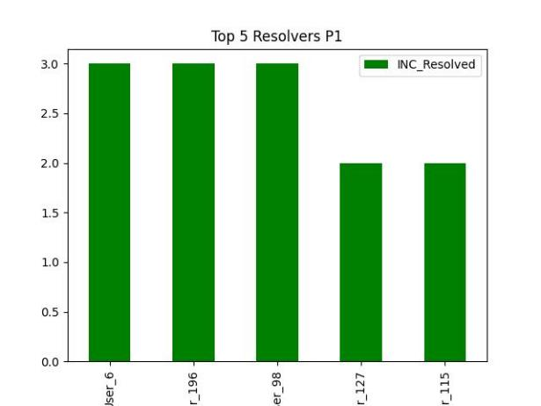
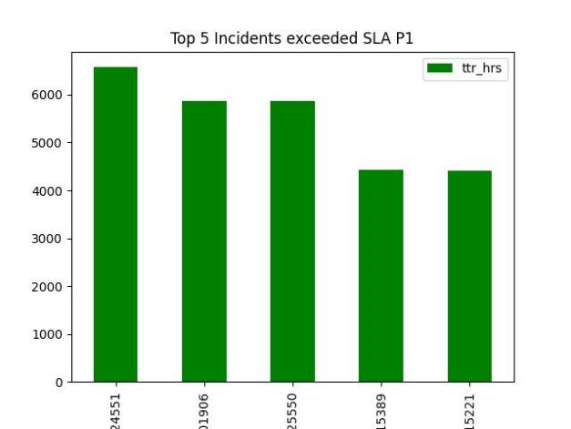
What extra has been implemented in the case study
We have also implemented the Graphical representation of the Incident report based on the priority using 'matplotlib'
This will help Business understand the complete overview of incident priority data.

Slide 29
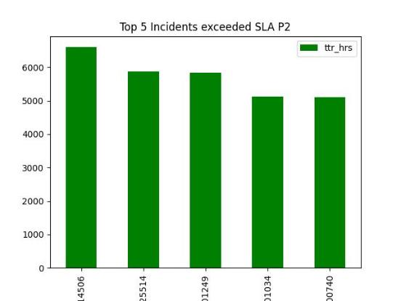
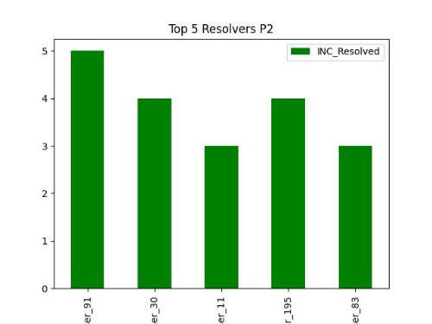
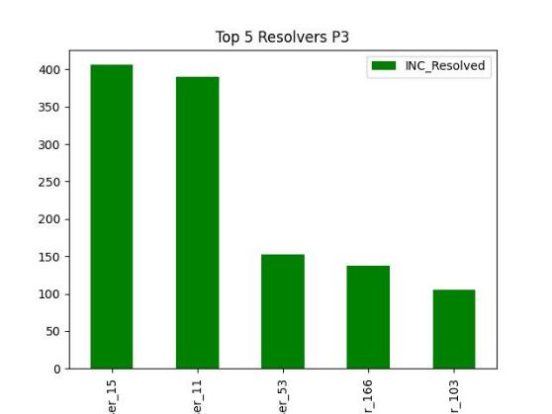
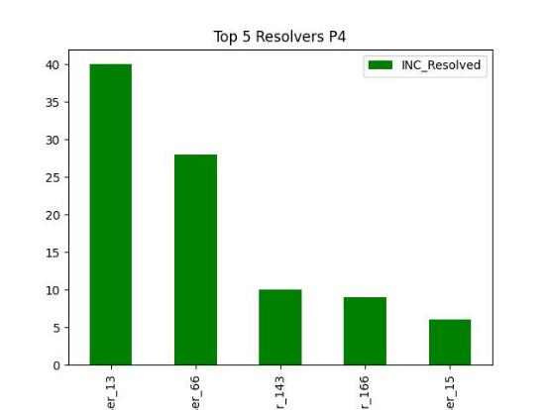
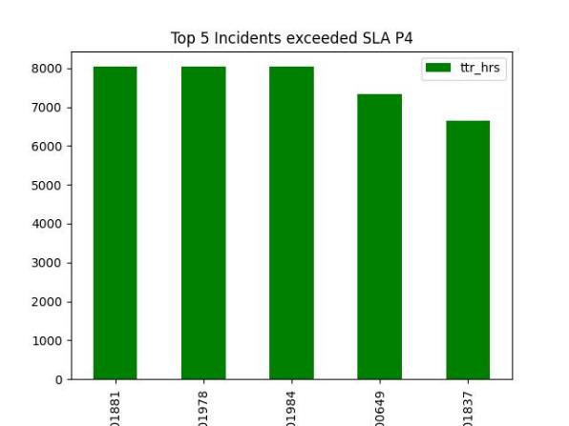
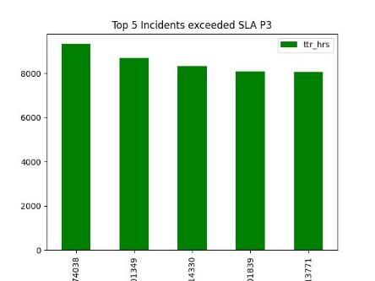
What extra has been implemented in the case study

Slide 30
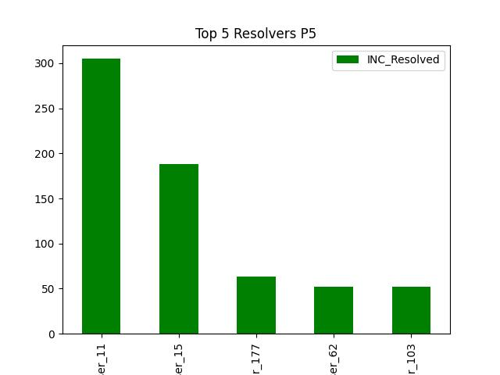
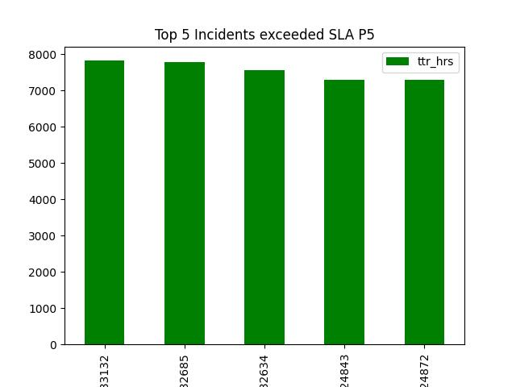
What extra has been implemented in the case study

Slide 31
Thank You

